Slide 1
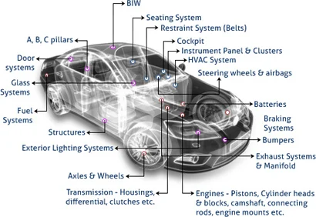

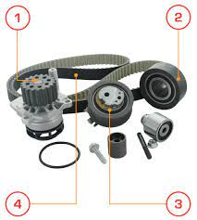


OPTIMIZATION OF KITITEM DISTRUBUTION

Slide 2



PROJECT LEDERSHIP
Bharani Kumar Depuru
Director & Co-Founder at Innodatatics
linkedin.com/in/bharanikumardepuru/
Sharat Manikonda
Director at Innodatatics and Sponsor
linkedin.com/in/sharat-manikonda/
Abirami Raghul
Associate Data Scientist @INNODATATICS
https://www.linkedin.com/in/abirami-raghul-515214253/

Slide 3

TEAM MEMBERS
Prince Kumar Gupta
Aspiring Data Scientist
linkedin.com/in/prince-kumargupta/

Slide 4
Contents
Business Objective
Business Constraints
Project Architecture
Data Collection
Exploratory Data Analysis
Data Visualization
Model Building
Evaluation
Deployment
Notes:
Change

Slide 5
Business Problem
A Leading automotive Manufacturer, facing difficulty in efficiently sourcing and providing unique kit items from various vendors to meet customer demands.

Slide 6
Project Overview and Scope
Overview:
Objective: Enhance the efficiency of kit item distribution for a leading automotive manufacturer.
Challenge: Difficulty in efficiently sourcing and providing unique kit items from various vendors to meet customer demands.
Scope:
Optimization Focus:
Maximize efficient kit delivery.
Maximize the supply consistency.
Success Criteria:
Business Success Criteria:
Minimize delay by at least 10%.
Machine Learning Success Criteria:
Achieve an accuracy of 90%.
Economic Success Criteria:
Achieve cost savings of at least $1M.
Approach:
Analyze current distribution processes and identify bottlenecks.
Implement machine learning algorithms for demand forecasting and inventory optimization.
Develop efficient vendor management strategies.
Deliverables:
Optimized distribution model.
Machine learning algorithms for demand forecasting.
Vendor management framework.

Slide 7
Data Dictionary
Variable Name | Variable description
Customer Code | Customer ID
Customer Name | Client / Customer Name
KIT ITEM | Kits required for each customer / clients
OEM | Original Manufacturer of each kititems
Item description | Items involved in each kits
Product type | Type of each item in the kit
Apr-21 to Dec -23 | Total of 33 columns where kit items are delivered
Total | Total of each kit items delivered
Note : | Empty/null is no allotment of the Kit item

Slide 8
Exploratory Data Analysis [EDA]
Statistical Insights
Business Insights
Mean, Median, and Mode:
Mean: The mean values range from as low as 2.48 to as high as 4632.58, suggesting a wide range of averages across different kits.
Median: The median values range from 4 to 1090, indicating the central tendency of the data.
Mode: The mode values vary widely, with some kits having modes at 0 and others at higher values.
Minimum and Maximum:
The minimum values range from 0 to 130, while the maximum values range from 1 to 7900, indicating a significant variability in the range of values across kits.
Skewness and Kurtosis:
Skewness measures the symmetry of the distribution. Positive skewness (values greater than 0) indicates that the distribution is skewed to the right, while negative skewness (values less than 0) indicates skewness to the left. In this dataset, most kits have positive skewness, indicating a right-skewed distribution.
Kurtosis measures the tails of the distribution. Positive kurtosis indicates heavier tails compared to a normal distribution, while negative kurtosis indicates lighter tails. Some kits have positive kurtosis, indicating heavier tails in their distributions.
Standard Deviation and Variance:
Standard deviation and variance measure the dispersion or spread of data points around the mean. Higher standard deviation and variance values indicate higher variability in the data. The standard deviation values range from 1.82 to 2194.17, while the variance values range from 3.32 to 4,779,835.52, indicating a wide range of variability across kits.
1. Identifying High-Performing Kits
- Kits with higher mean values may indicate higher sales, usage, or demand.
- Understanding which kits have consistently high median and mode values can help identify popular products.
2. Detecting Low-Performing Kits
- Kits with consistently low mean, median, and mode values may indicate products that are not performing well in terms of sales or demand.
- Identifying these low-performing kits can help in strategizing marketing efforts or product improvements.
3. Understanding Variability and Stability:
- Kits with high standard deviation and variance values indicate high variability in their performance or demand.
- Understanding the factors contributing to this variability can help in managing inventory, production, and marketing strategies.
4. Addressing Skewness and Kurtosis:
- Positive skewness and kurtosis indicate distributions skewed to the right and heavier tails, respectively.
- Identifying the reasons behind these skewed distributions can help in addressing potential outliers, understanding customer preferences, and optimizing product offerings.
5. Spotting Potential Opportunities and Threats:
- Kits with unexpected outliers or extreme values may indicate hidden opportunities or threats in the market.
- Exploring the reasons behind these outliers can help in capitalizing on emerging trends or mitigating risks associated with underperforming products.
6. Optimizing Inventory and Production:
- Understanding demand patterns and variability can help in optimizing inventory levels and production schedules.
- By focusing resources on high-demand kits and adjusting production levels for low-demand kits, businesses can improve efficiency and reduce costs.
Notes:
EDA is used for seeing what the data can tell us before the modeling task.
Change

Slide 9
Data Preprocessing
Preprocessing Steps Overview
Data Acquisition & Loading:
Connect to MySQL database.
Load data from CSV to MySQL.
Data Cleaning:
Remove irrelevant columns.
Set 'KIT ITEM' as index.
Transpose DataFrame.
Aggregate duplicate columns.
Handling Missing Values:
Replace missing values with zeros.
Remove columns with high zero proportion.
Impute zeros with column medians.
Business Moments Calculation:
Compute statistical moments.
Store moments in CSV.
Stationarity Tests:
Check time series stationarity.
Decompose time series.
Save results in Word document.
Notes:
Keep observations

Slide 10
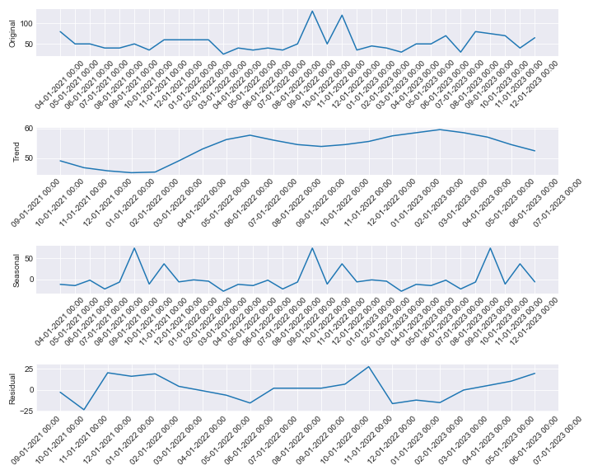
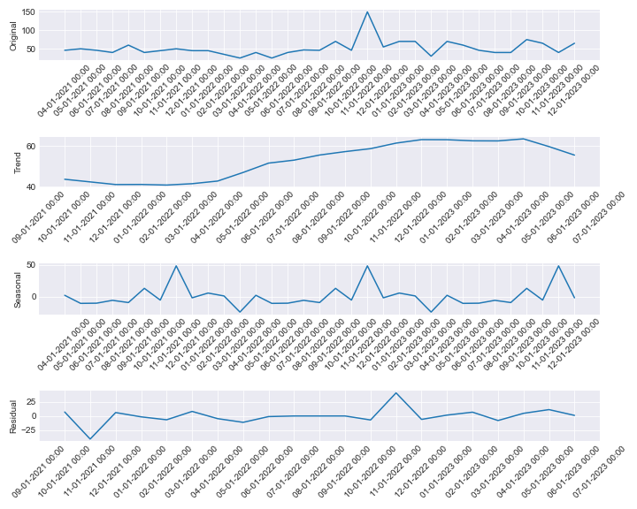
Data Visualization
Stationary tests for KIT0000896
ADF Test - p-value: 0.004195433845132723
ADF Test: Series is stationary
KPSS Test - p-value: 0.1
KPSS Test: Series is stationary
Stationary tests for KIT0000897
ADF Test - p-value: 9.967147187920143e-06
ADF Test: Series is stationary
KPSS Test - p-value: 0.1
KPSS Test: Series is stationary
For every column you can refer to the word document click me
Notes:
Add graphical

Slide 11
Model Building
Considered Models:
Arima
Sarima
Sarimax
ExponentialSmoothing
Autoregressive Model
Approach:
Models were trained and validated using historical data, with a focus on minimizing overfitting.

Slide 12

Model Deployment - Strategy
Deployment Plan:
The deployment strategy involves integrating the model into the existing system, with a phased rollout plan.
And I deployed model in local free, open-source Python framework streamlit

Slide 13
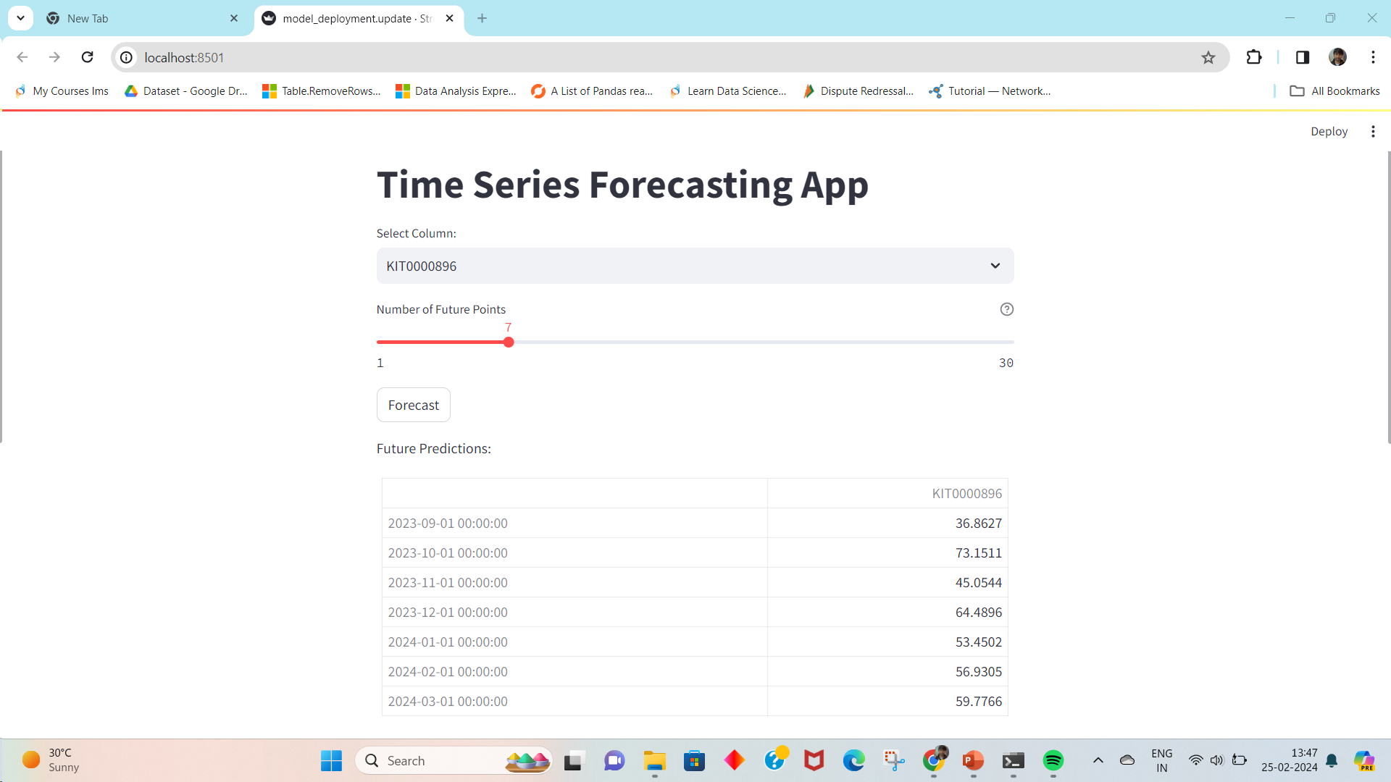
Screen shot of output

Slide 14


